Slide 1
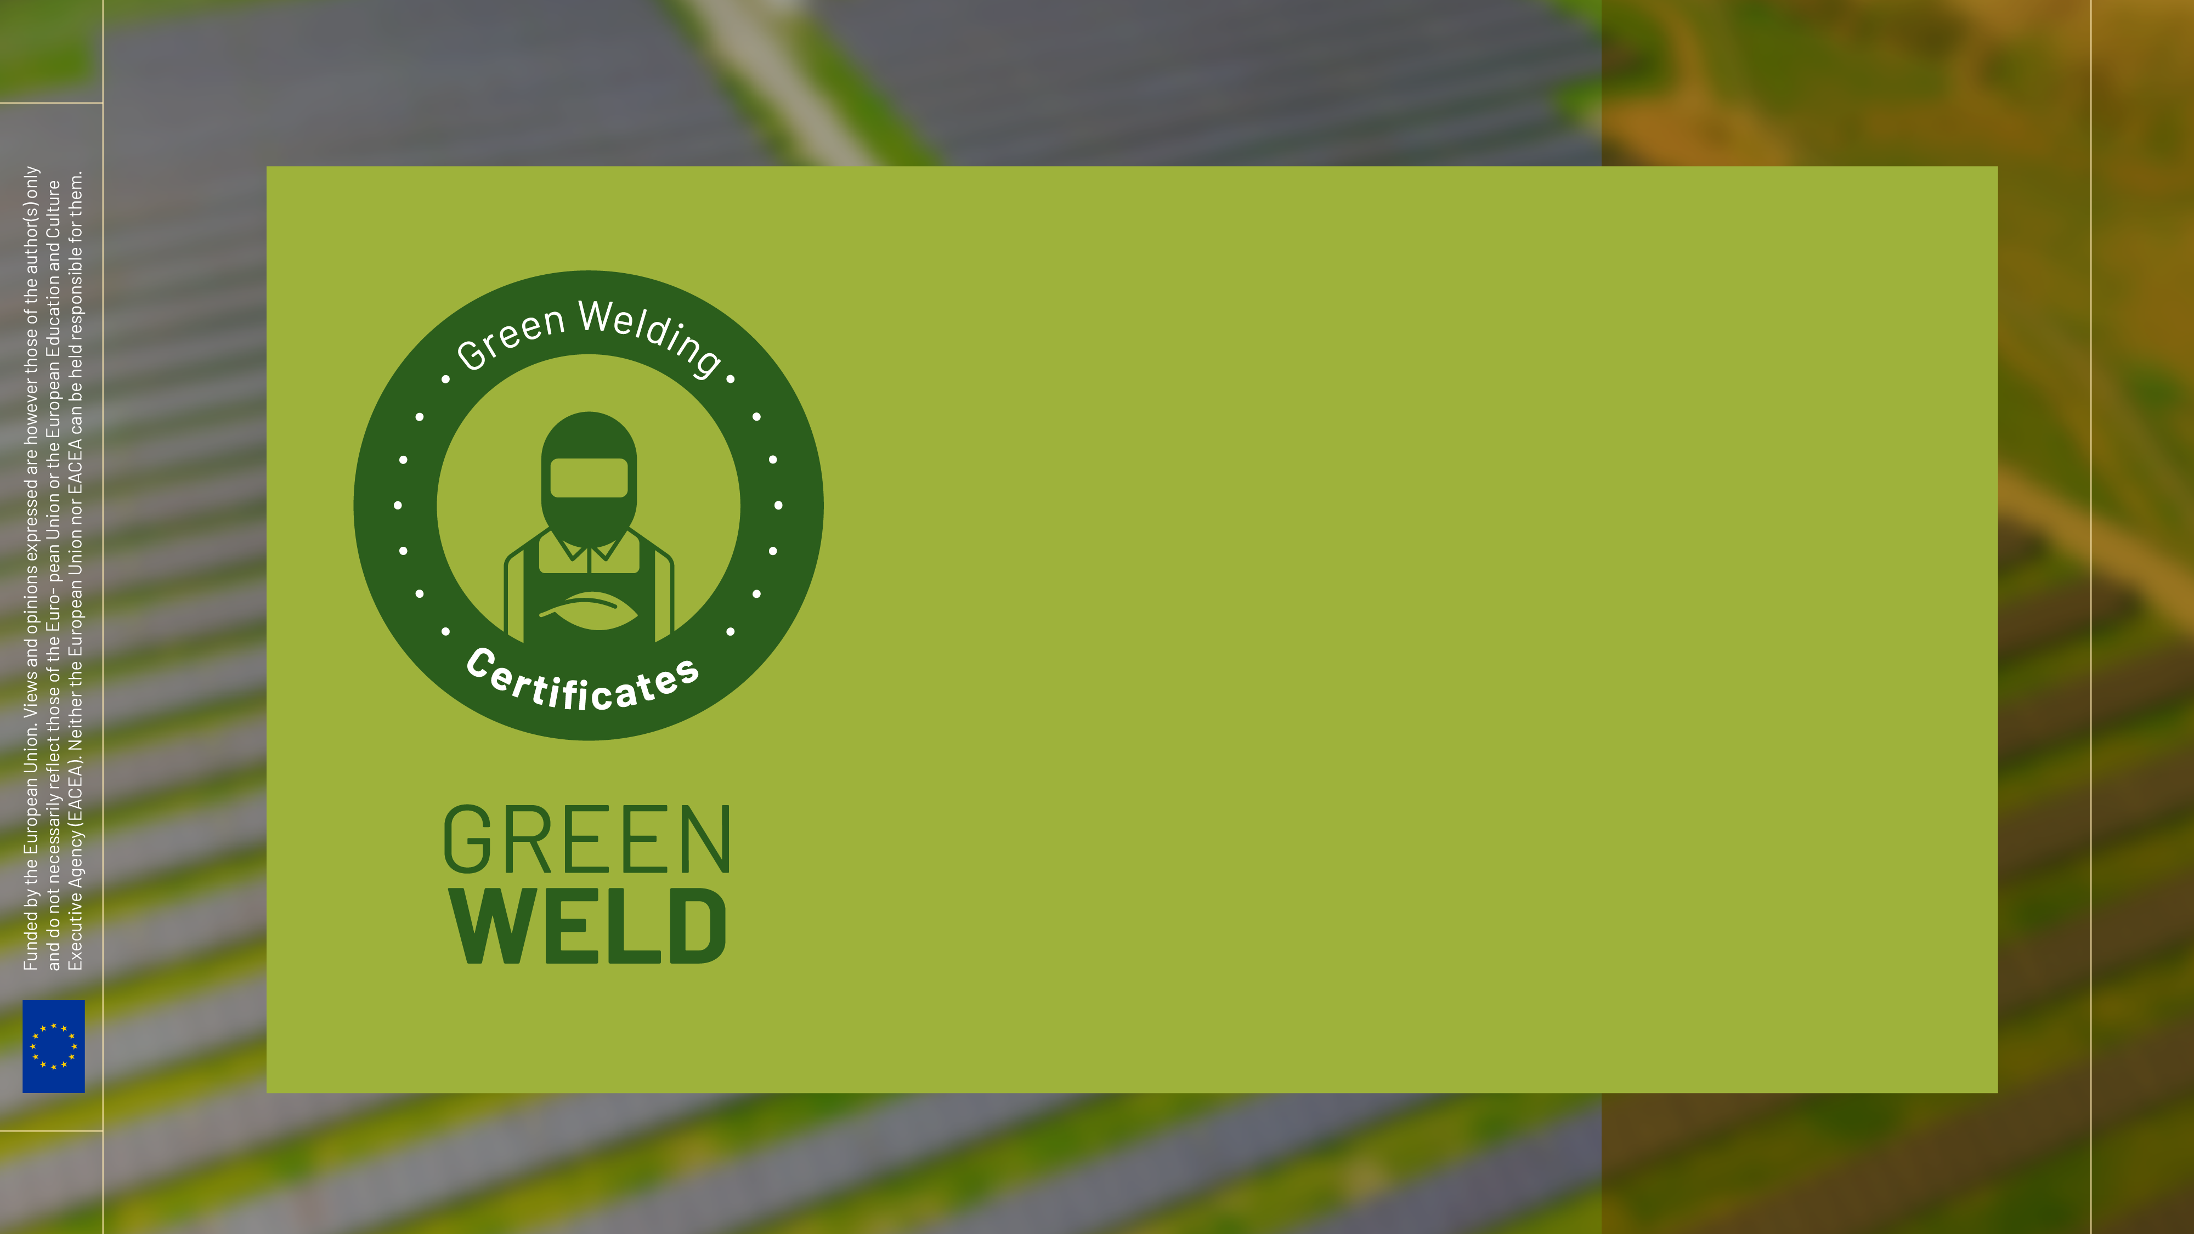
Awareness in Green Topis: Reduce, Recycle, Reuse - Part B

Slide 2
Index
ENVIRONMENTAL AWARDNESS AND GREEN WELDING ADAPATION TRAINING FOR WELDERS
Waste and Material Reduction Module
Maximizing materials recovery
Reducing in welding processes
Different welding techniques and reduction in additional post-processes.
Optimization of joint preparation to the thickness to be welded.

Slide 3
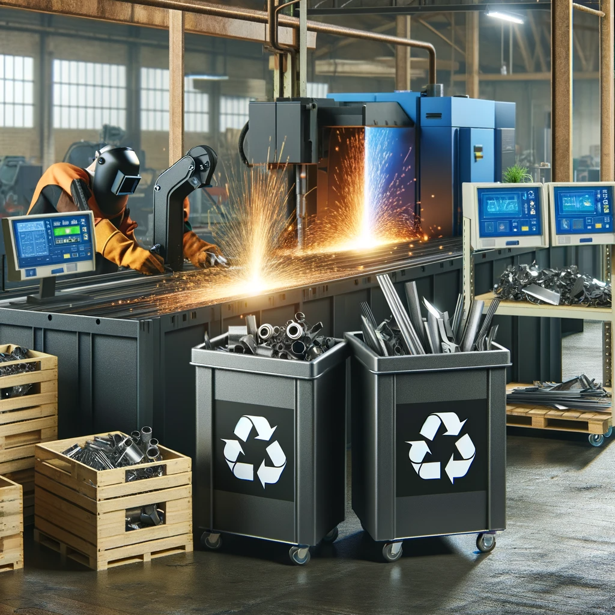
ENVIRONMENTAL AWARDNESS AND GREEN WELDING ADAPATION TRAINING FOR WELDERS
Waste and Material Reduction
OBJETIVES
1. Maximizing Material Recovery:
Efficiency in Material Usage:
The importance of using adequate cutting and welding techniques is very important to maximize material utilization.
This includes methods for optimizing edges preparation to minimize waste, following the drawings indications and selecting welding processes that maximize material use and energy consumption, according to the ranges of welding procedures specifications.
Recycling Metal Waste:
Follow an effective recycling system in the workshop is mandatory to optimize the materials. This may include separating different types of metals, optimize the materials, and collaborating with local recycling facilities.

Slide 4
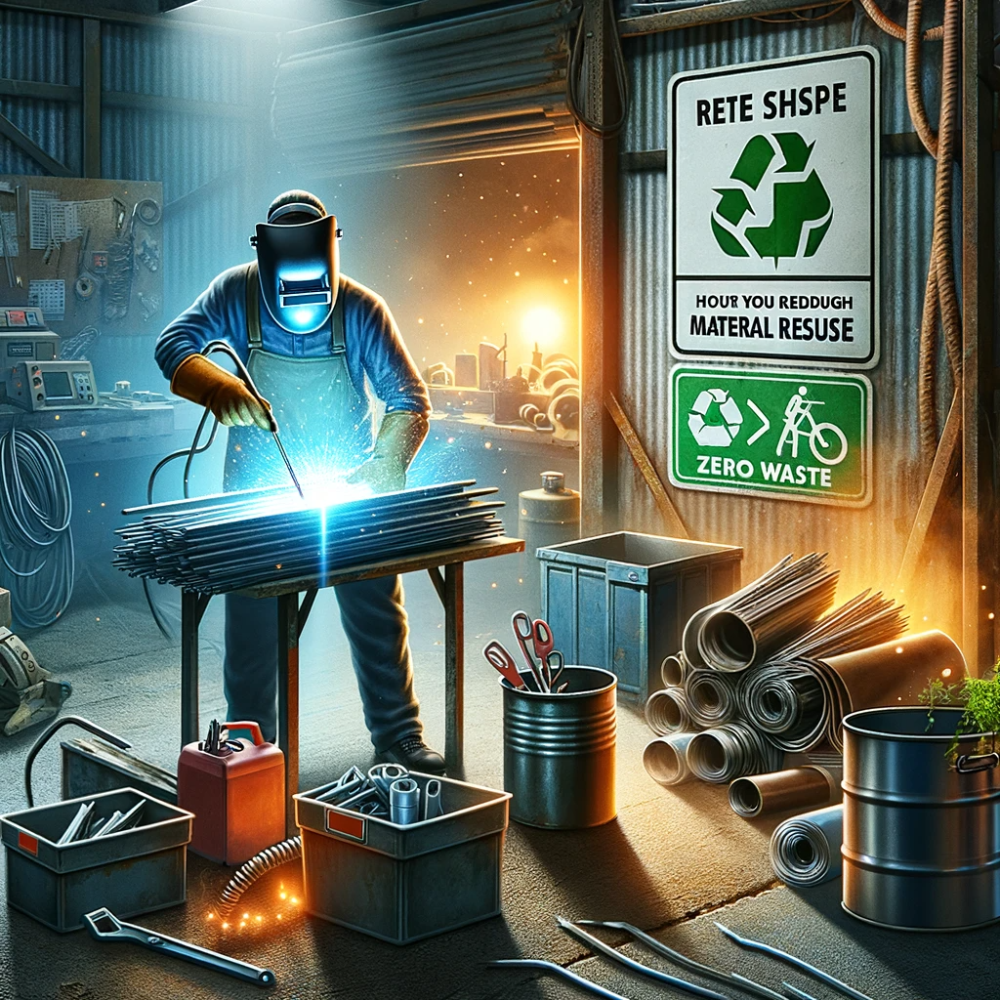
ENVIRONMENTAL AWARDNESS AND GREEN WELDING ADAPATION TRAINING FOR WELDERS
Waste and Material Reduction
OBJETIVES
2. Reducing Waste in Welding Processes:
Material Reuse: Understand how to identify opportunities for reusing materials in the workshop. Include practical examples, such as using leftovers to create useful tools or artifacts, or for experimental welding practices.
Environmental Awareness: Understand about the impact of welding waste on the environment and how sustainable practices can make a positive contribution. Following 'zero waste' policies and promoting an approach of environmental responsibility among peers.

Slide 5
ENVIRONMENTAL AWARDNESS AND GREEN WELDING ADAPATION TRAINING FOR WELDERS
Waste and Material Reduction
OBJETIVES
3. Welding Techniques and Reduction of Repairs:
Selection of Welding Techniques: Expand on how different welding techniques (like MIG, TIG, and submerged arc) adapt to different types of materials and projects. Discuss how the right choice of technique can influence the quality of the weld and reduce the need for touch-ups or repairs, which in turn reduces waste.
Quality over Quantity: Learn techniques to improve the precision and quality of the weld. This includes training in temperature control, welding speed, and electrode manipulation and gases management techniques to minimize defects and the need for rework.

Slide 6
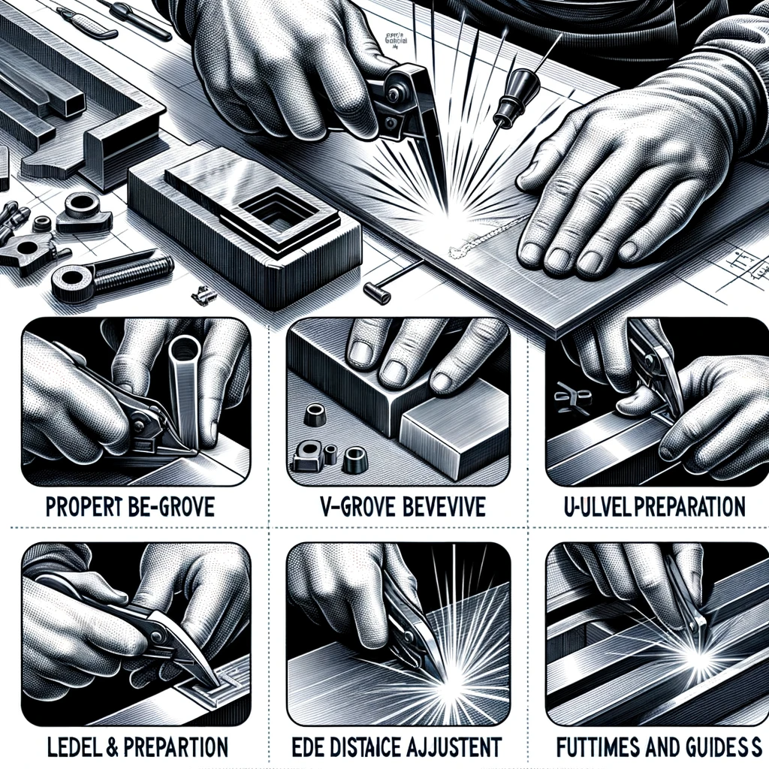
ENVIRONMENTAL AWARDNESS AND GREEN WELDING ADAPATION TRAINING FOR WELDERS
Waste and Material Reduction
OBJETIVES
4. Optimization of Joint Preparation:
Efficient Joint Preparation: Explore joint preparation techniques that not only enhance welding quality but also minimize energy consumption.
Relation between Joint Preparation and Energy: Understand the concept of the interconnectedness between joint preparation choices and energy conservation in welding operations. Learn about joint designs that optimize material usage and minimize the need for excessive welding passes. Emphasize the relationship between joint preparation and heat input during welding.

Slide 7
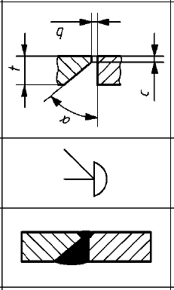
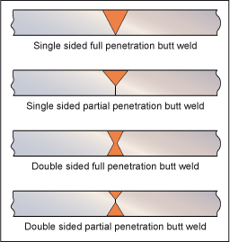
ENVIRONMENTAL AWARDNESS AND GREEN WELDING ADAPATION TRAINING FOR WELDERS
Waste and Material Reduction
1. Maximizing Material Recovery:
Importance of welding preparations:
Respecting the geometry of the joint preparations for the welded joints is very important, since now times and material input in the execution of the welding.
An X preparation need less filler metal than V preparation.
A more open or closed angle may mean a lack of penetration or greater deformations, which would require extra repair work.
More accuracy,
less scraps.

Slide 8
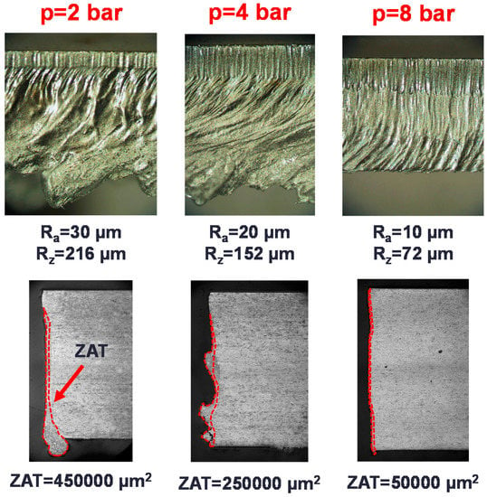
ENVIRONMENTAL AWARDNESS AND GREEN WELDING ADAPATION TRAINING FOR WELDERS
Waste and Material Reduction
1. Maximizing Material Recovery:
The parameters of cutting contributes to the overall efficiency of the welding process.
An incorrect parameters of cutting, may involve extra preparation work, due to the need for additional grinding, which requires greater energy and material consumption.
Better preparation,
less consumption
of materials.

Slide 9
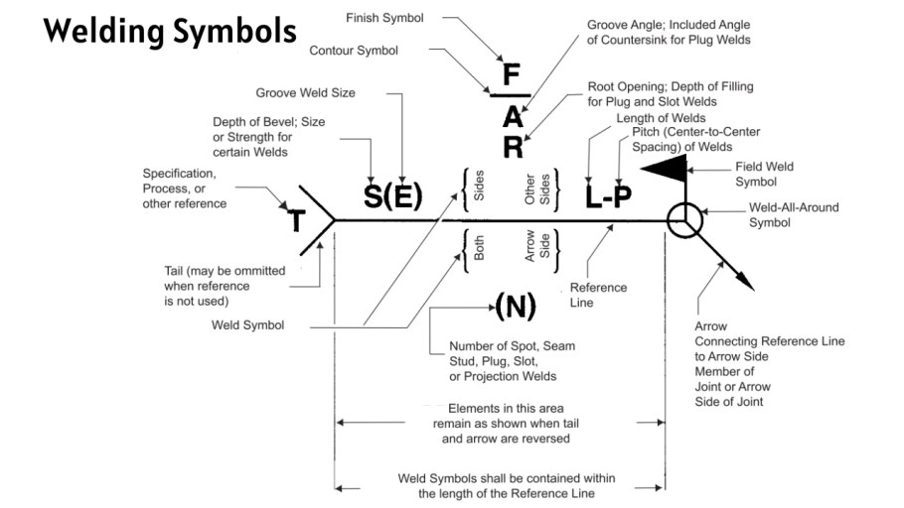
ENVIRONMENTAL AWARDNESS AND GREEN WELDING ADAPATION TRAINING FOR WELDERS
Waste and Material Reduction
1. Maximizing Material Recovery:
Understanding Welding Symbols and Drawings:
Allows joints to be made "the first time", and to manage materials more efficiently, reducing the percentage of scrap.
Less reparations, less scraps,
less consumption of materials.

Slide 10
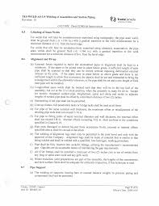
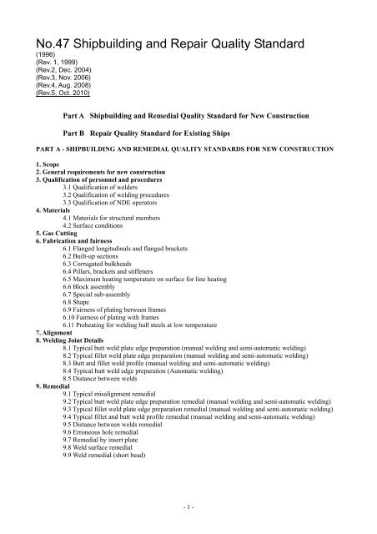
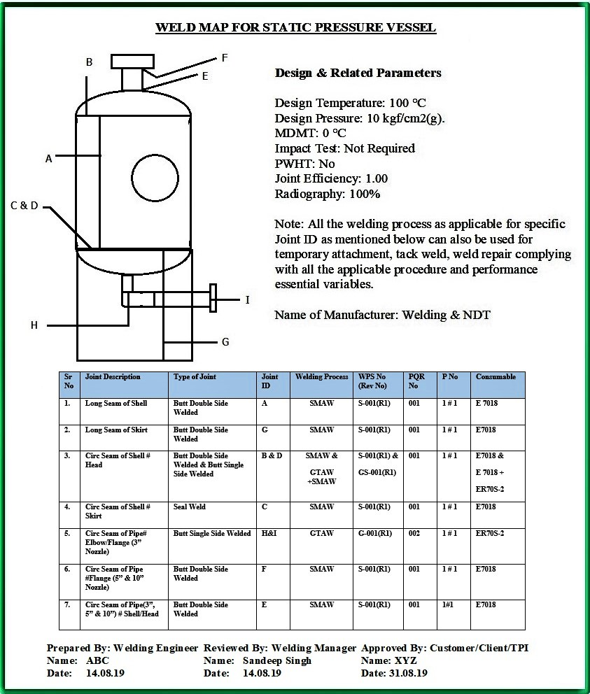
ENVIRONMENTAL AWARDNESS AND GREEN WELDING ADAPATION TRAINING FOR WELDERS
Waste and Material Reduction
1. Maximizing Material Recovery:
Understanding Welding Symbols and Drawings:
Is important to understand project specifications, because very important details of the execution of the joints may appear, as well as admissible tolerances, and other construction details.
Follow a different assembly sequence or incorrect joints geometry, may cause poor use of the base material or repairs.
Follow the planning.

Slide 11
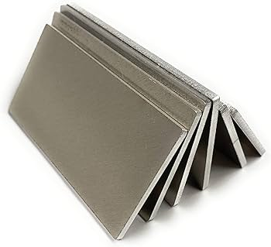
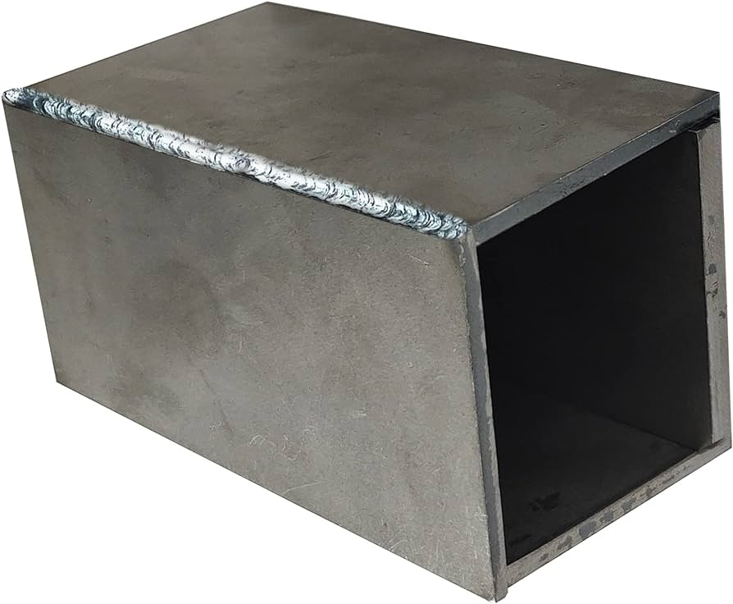
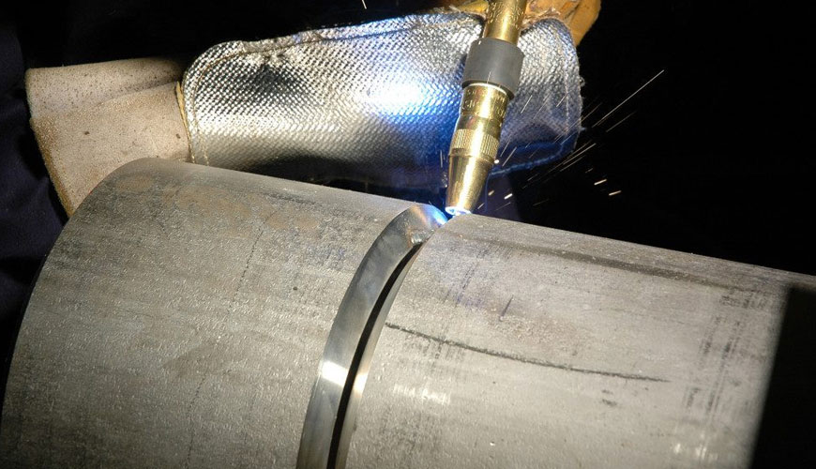
ENVIRONMENTAL AWARDNESS AND GREEN WELDING ADAPATION TRAINING FOR WELDERS
Waste and Material Reduction
2. Reducing Waste in Welding process:
Material Reuse:
The welding coupons to qualify procedures can be extracted from scraps of material, and if they are not acceptable, reused again for previous tests.
Test before start
the production
Before start the production is important to check the welding parameters from the procedure specification. A good practice is to have models or part sections on which to rehearse.

Slide 12
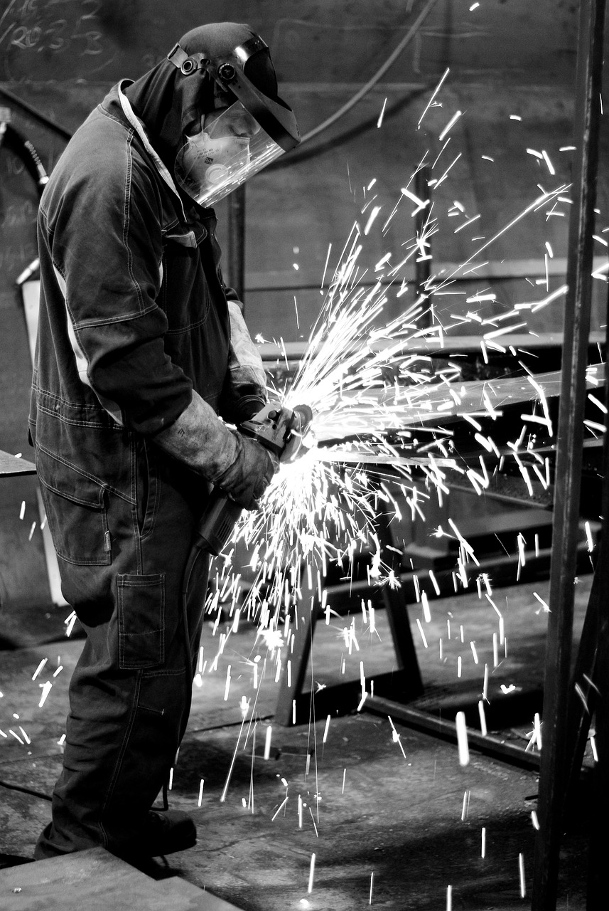
ENVIRONMENTAL AWARDNESS AND GREEN WELDING ADAPATION TRAINING FOR WELDERS
Waste and Material Reduction
2. Reducing Waste in Welding process:
Environmental Awareness:
The process of welding generates metal fumes, both from the metals being welded, from the fillers being used, and from the fluxes or shielding gasses being used. These fumes, released into the environment, can lead to poisoning the air, land, and water, as well as people or animals in the area.
The electricity used in welding has to come from somewhere. As a very energy-intensive process, any steps taken to reduce energy consumption or make welding more energy-efficient can be beneficial to the environment, even if it is many steps removed from the generation of that energy.
Welding has many consumables, many of which have debris or remains that are simply discarded as waste. This only scratches the surface; a comprehensive analysis of welding processes shows a wide range of potential environmental contaminants and impacts across the industry.
Think in green .

Slide 13
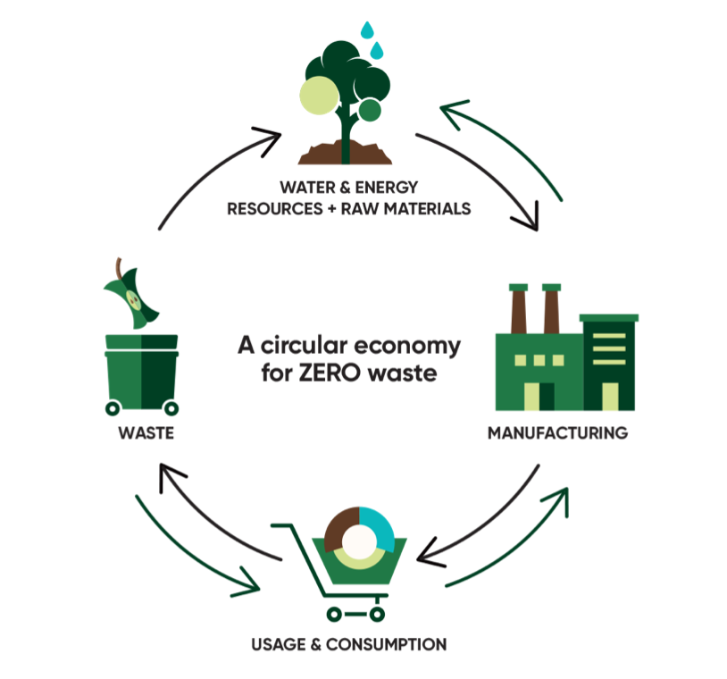
ENVIRONMENTAL AWARDNESS AND GREEN WELDING ADAPATION TRAINING FOR WELDERS
Waste and Material Reduction
2. Reducing Waste in Welding process:
Environmental Awareness Good practices:
Skip the Feel-Good, No-Impact Gimmicks
Examine Waste and Recycle Anything That Can Be Recycled
Choose a Less Impactful Welding Process
Use Automation to Increase Speeds and Decrease Waste
Use a Fume Extraction System to Avoid Releasing Contaminants
Switch to Eco-Friendly Consumables
Choose in Energy-Efficient Welding Systems
Use Virtual Reality for Operator Training
Good practices,
Less environmental impact

Slide 14
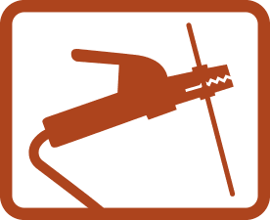
ENVIRONMENTAL AWARDNESS AND GREEN WELDING ADAPATION TRAINING FOR WELDERS
Waste and Material Reduction
3. Welding techniques and reduction of Repairs:
Selection of Welding Techniques:
Shielded Metal Arc Welding (SMAW) is commonly referred to as “STICK” welding and uses a stinger – the handle that holds the weld rod.
Advantages
Lower equipment cost than GTAW, FCAW and GMAW. (No bottle, gas hose, flowmeter, or TiIG rig/Wire feeder needed).
Quick Change from one material to another.
The process lends itself to welding in confined spaces and various positions with few problems.
Deposition rates faster than GTAW Manual
Easy to move from one location to another. No Wire Feeder and Bottle.
Requires no outside shielding gas and can be used outdoors in light to medium wind.
The ability to bend the electrode and the small space the electrode takes allows the process to be used in comparatively tight spaces.
Disadvantages
Low deposition rate compared to GMAW/FCAW.
Filler metal cost per weld can be greater due to a low deposition efficiency that can vary greatly with stub length.
Production factor is typically lower due to rod changes and chipping slag (unless welding on various materials).
Needs more hand-eye coordination than GMAW/FCAW.
Slag must be removed as compared to GTAW/GMAW

Slide 15
ENVIRONMENTAL AWARDNESS AND GREEN WELDING ADAPATION TRAINING FOR WELDERS
Waste and Material Reduction
3. Welding techniques and reduction of Repairs:
Selection of Welding Techniques:
Gas Metal Arc Welding (GMAW) is commonly referred to as “MIG” welding and uses a “MIG gun” with a wire feeder.
Advantages
High deposition efficiency when used in certain transfer modes.
No slag to chip as compared to SMAW and FCAW
The process can be used on thin materials with relative ease, if properly set.
Lower hydrogen weld deposit with all electrodes.
High production factor since no slag is required to be removed and uses a continuous electrode.
With the parameters properly set for the application, most people can weld after a very short amount of practice.
One given electrode size can be used on various thicknesses of materials productively, as compared to SMAW and GTAW
Disadvantages
Requires a wire feeder, which is difficult to move and can sometimes be a maintenance/repair burden.
Needs shielding gas, making welding in windy conditions difficult. Generally is not suitable for windy conditions.
Out of position welds are sometimes more difficult.
Increased chance of lack of fusion if parameters and welding technique are not controlled.
The gun is difficult to get into tight places.

Slide 16
ENVIRONMENTAL AWARDNESS AND GREEN WELDING ADAPATION TRAINING FOR WELDERS
Waste and Material Reduction
3. Welding techniques and reduction of Repairs:
Selection of Welding Techniques:
Gas Tungsten Arc Welding (GTAW) is commonly referred to as TIG welding.
Advantages
GTAW welding offers more precision and higher quality when compared to other welding techniques.
It is a difficult skill to learn for many people because you must hold the welding torch in one hand and the filler material in the other for a successful result.
GTAW welding uses a cleaner process and you can operate a GTAW welder in almost any position.
GTAW welding allows you to choose the precise amperage for your work.
You can weld more types of metals and alloys with GTAW welding processes.
GTAW welding processes are useful for welding chrom alloy, aluminum, steel, nickel alloys, stainless steel, copper, brass, magnesium, and even gold.
There are fewer fumes and less smoke when GTAW welding.
You don’t need to purchase multiple shielding gases to work efficiently, as Argon gas is typically used for most GTAW welding applications.
The cost of a GTAW welder is comparable to the other methods.
Disadvantages
GTAW welding is more expensive than the other processes available.
Poor gas coverage can lead to contamination issues.
You need to understand the correct polarity for your welds.
Overheating can be a significant problem when GTAW welding.
GTAW welding requires higher skill sets and is a much slower process comparatively.

Slide 17
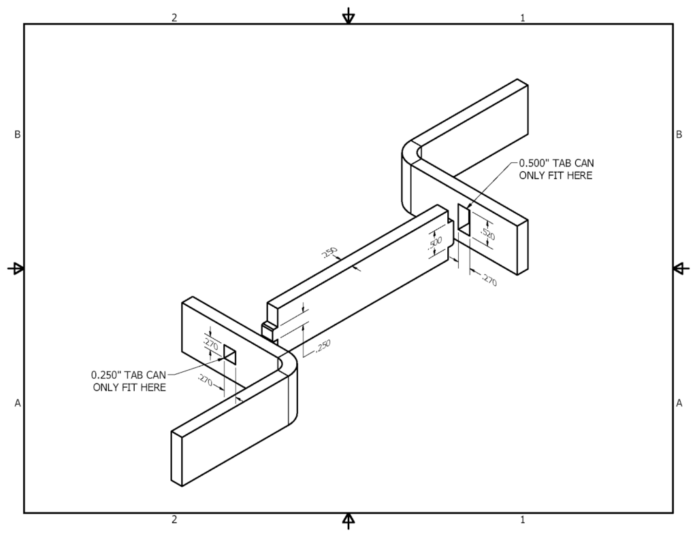
ENVIRONMENTAL AWARDNESS AND GREEN WELDING ADAPATION TRAINING FOR WELDERS
Waste and Material Reduction
3. Welding techniques and reduction of Repairs:
Quality over Quantity:
Include tabs and slots and cleco holes ‍
Tabs and slots reduce the need for complicated fixtures by interlocking metal parts with tabs on one piece of metal and slots, or holes, on the other. Designing your parts with tabs and slots enables welders to assemble your parts faster and more efficiently. You can also use tab and slot to ensure that parts are orientated correctly prior to being welded together. Essentially these can serve as error proofing the process, while also greatly improving the efficiency of welding them together. Similarly, cleco holes also help the welders locate the exact location to weld parts together, and these holes can be filled in if needed.
Less geometry divergences,
Less resources for repairing

Slide 18
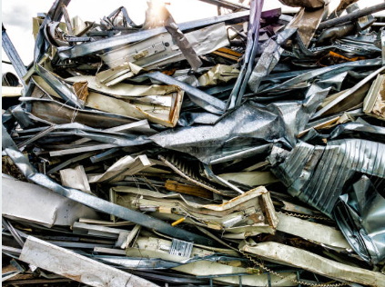
ENVIRONMENTAL AWARDNESS AND GREEN WELDING ADAPATION TRAINING FOR WELDERS
Waste and Material Reduction
3. Welding techniques and reduction of Repairs:
Quality over Quantity:
Follow the WPS
2. Select the right material for your project
It´s very important to choose your project’s material wisely.
If you change a material quality or thickness, It is very likely that you will have to scrap anything that has been manufactured under these conditions.
.
3. Reduce gap sizes or eliminate gaps completely
While there are techniques we can use to fill gaps, it’s best to start with the smallest gaps possible to enable faster welding.

Slide 19
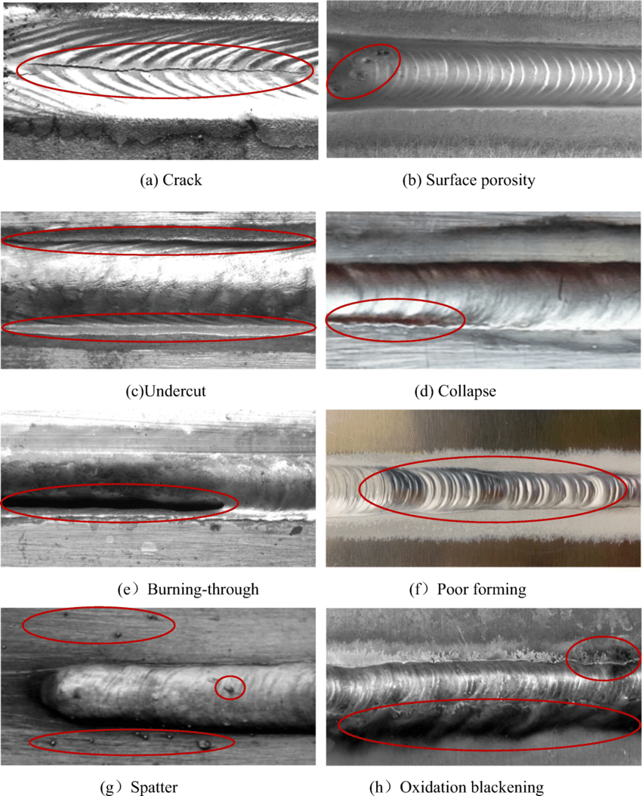
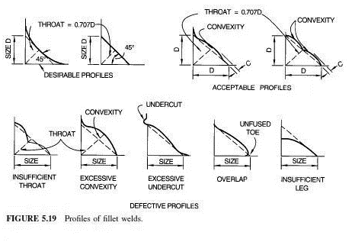
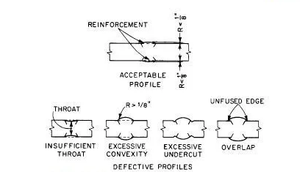
ENVIRONMENTAL AWARDNESS AND GREEN WELDING ADAPATION TRAINING FOR WELDERS
Waste and Material Reduction
3. Welding techniques and reduction of Repairs:
Quality over Quantity:
4. Choose the right tolerances and quality of welds.
Avoid reparations or scraps for not achieving tolerances or acceptance quality criterias.
Be precise with the dimensions.

Slide 20
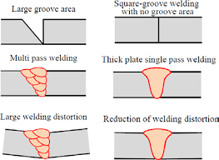
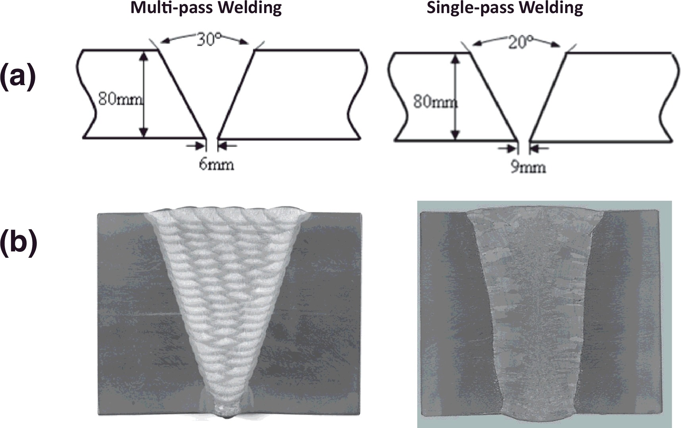
ENVIRONMENTAL AWARDNESS AND GREEN WELDING ADAPATION TRAINING FOR WELDERS
Waste and Material Reduction
4. Optimization of joint preparation:
Efficient Joint Preparation:
Reducing the volume of weld metal.
To minimize distortion, as well as for economic reasons, the volume of weld metal should be limited to the design requirements.
For a single-sided joint, the cross-section of the weld should be kept as small as possible to reduce the level of angular distortion.
Reducing the volume of metal, we will reduce the material, energy and gas comsumption.
Reducing the number of runs
The degree of angular distortion is approximately proportional to the number of passes.
Reducing the distorsion, we will reduce the energy to elimitate this effect, and avoid the possibility of scrap.
Choose the best setting

Slide 21
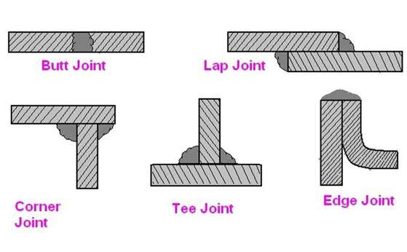
ENVIRONMENTAL AWARDNESS AND GREEN WELDING ADAPATION TRAINING FOR WELDERS
Waste and Material Reduction
4. Optimization of joint preparation:
Relation between Joint Preparation and Energy:
Efficient joint designs play a crucial role in minimizing energy expenditure during welding. By selecting appropriate joint configurations, welders can reduce the amount of filler material and welding passes needed. This not only conserves energy but also contributes to cost savings and a more sustainable welding process.
The amount of heat required during welding is influenced by joint preparation. Welding thicker materials or using improper joint designs may demand higher heat input, leading to increased energy consumption. On the other hand, precise joint preparation that matches material thickness and welding requirements can optimize heat input, promoting energy efficiency.

Slide 22
Any questions?
Thank you!

