Slide 1
Awareness in Green Topis: Reduce, Recycle, Reuse - Part A2-1

Slide 2
2.5 Training and Awareness of Personnel
- Train welders and related staff on safe and environmentally respectful work practices.
- Promote a culture of environmental responsibility in the workplace.

Slide 3
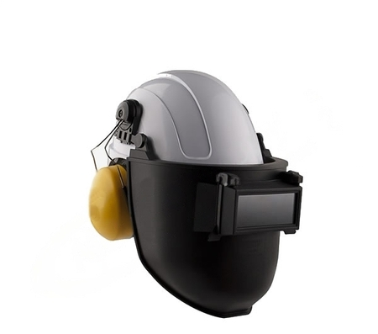
2.6 Noise Minimization
- Use welding techniques and equipment that generate less noise.
- Implement acoustic barriers if necessary, to minimize the impact of noise on the environment.

Slide 4
2.7 Use of Alternative Welding Techniques
Consider using welding techniques that generate less smoke and waste, such as TIG or MIG welding, instead of more polluting methods. Use welding technologies that minimize waste generation, like Friction Stir Welding (FSW), which is particularly effective in joining aluminum and produces less waste compared to traditional methods.

Slide 5
2.8 Regular Inspections and Maintenance
- Conduct regular inspections to ensure that welding equipment and processes are not causing environmental damage.
- Properly maintain equipment to prevent leaks and other problems that may be harmful to the environment.
Implementing these practices not only helps protect the environment but can also improve safety and efficiency in the workplace.

Slide 6
3. Usage and Handling of welding materials
3.1 Usage and Handling of Welding Materials
3.2 Pollution Level of Each Welding Process and Recommendations
3.3 Conclusion and Recommendation

Slide 7
3.1 Usage and Handling of Welding Materials
Welding processes, while essential in many industries, can have significant environmental and health impacts due to the nature of the materials used and the emissions generated. Here are key points on the usage and handling of welding materials:
1. Safe Storage of Materials: Welding materials like electrodes, wires, and gases should be stored safely to prevent accidental releases or exposures. Proper ventilation in storage areas is crucial to prevent the build-up of harmful gases.
2. Proper Disposal of Waste: Used electrodes, slag, and other welding waste should be disposed of in accordance with environmental regulations. Recycling should be considered wherever possible to minimize waste.
3. Use of Protective Equipment: Welders should use appropriate personal protective equipment (PPE), such as respirators and fume extractors, to minimize exposure to harmful fumes and gases.
4. Training and Awareness: Regular training on safe handling, storage, and disposal of welding materials is essential to ensure worker safety and environmental protection.

Slide 8
3.2 Pollution Level of Each Welding Process and Recommendations
Different welding processes emit varying levels of pollutants. Here's a brief overview with recommendations for using less polluting processes:
1. SMAW (Stick Welding): High emission of fumes and gases. Covered welding electrodes are evolving to emit less smoke and harmful gases. These cleaner electrodes reduce exposure to hazardous substances and minimize air pollution. Use alternatives where possible, especially in confined spaces.
2. GMAW (MIG Welding): Moderate emissions, but more controlled compared to SMAW. Consider using when precision and control are needed.
3. GTAW (TIG Welding): Low emission of fumes. Preferred for its cleaner operation, especially in stainless steel and aluminum welding.

Slide 9
4. FCAW (Flux-cored Arc Welding): Generates significant fumes, but can be more efficient than SMAW. Use with proper ventilation.
5. SAW (Submerged Arc Welding): Lower fume emission due to the flux covering, but waste from slag needs proper disposal.
6. Laser and Ultrasonic Welding: Very low pollution, ideal for high precision and clean welding requirements, though limited in application due to equipment cost and material limitations.

Slide 10
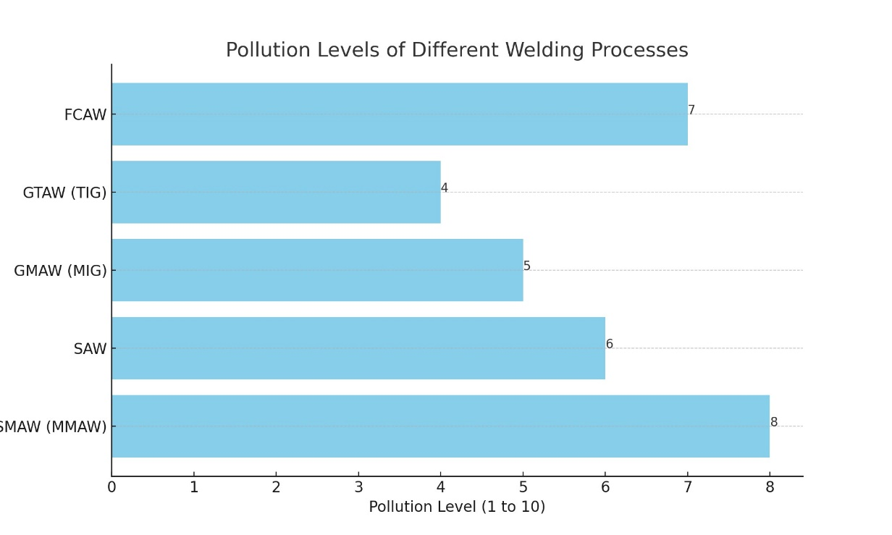
Below we will show an approximate graph in which you can assess the difference between different welding methods when it comes to generating waste and contamination.

Slide 11
3.3 Conclusion and Recommendation
The choice of welding process should consider both the application requirements and the environmental impact. Wherever possible, preference should be given to processes with lower emissions, like GTAW (TIG), laser, or ultrasonic welding. Implementing effective ventilation systems, using eco-friendly materials, and ensuring proper waste disposal are key to reducing the environmental footprint of welding activities. As technology advances, seeking out and adopting newer, cleaner welding techniques can significantly contribute to sustainability in the welding industry.

