Slide 1
Awareness in Green Topis: Reduce, Recycle, Reuse - Part A2-2

Slide 2
4. Recycling carbon steel, stainless steel and aluminium
4.1 Carbon Steel:
4.2 Stainless steel:
4.3 Aluminum:
4.4 General Sustainability Practices in Welding:

Slide 3
4.1 Carbon Steel:
In welding processes involving carbon steel, recycling plays a key role in efficient resource management. During welding, scraps and offcuts of carbon steel are generated, which can be collected for reuse. These remnants, often resulting from cuts and adjustments in the fabrication of structures or components, represent a valuable source of recyclable material.
Recycling these carbon steel scraps not only reduces the amount of waste destined for landfills but also decreases the need for mining new mineral resources. Carbon steel maintains its structural properties after recycling, allowing it to be melted and reshaped into a wide range of new products. This recycling process significantly contributes to environmental sustainability by reducing the carbon footprint associated with new steel production.
To maximize the efficiency of recycling in carbon steel welding, it is essential to implement collection and sorting systems in workshops and welding sites. This facilitates the separation of carbon steel remnants from other materials and ensures that the maximum possible amount is collected for recycling

Slide 4
4.2 Stainless steel:
Recycling in stainless steel welding presents its own challenges and opportunities. As stainless steel is used in applications ranging from construction to the manufacture of kitchen utensils and medical equipment, the scraps and offcuts generated during welding are equally valuable for recycling.
An important consideration in recycling stainless steel is the need to properly classify the different types of alloys. Stainless steel comes in various compositions, each with specific properties and uses. This classification is crucial for maintaining the quality and desired characteristics of recycled stainless steel.
Once collected and classified, stainless steel undergoes a process of crushing and cleaning to prepare it for melting. During the melting process, the composition of stainless steel can be adjusted by adding or removing elements to achieve the desired quality. Similar to carbon steel, recycling stainless steel helps conserve natural resources and reduces the carbon footprint associated with new material production.
The effective implementation of recycling practices in stainless steel welding is not only beneficial from an environmental standpoint but can also offer economic advantages by reducing the need for new and costly materials.

Slide 5
In summary, in both carbon and stainless steel welding, recycling is a key element in promoting sustainability and efficiency in the industry. By adopting recycling practices, welding operations can minimize their environmental impact and contribute to a more circular and sustainable economy.

Slide 6
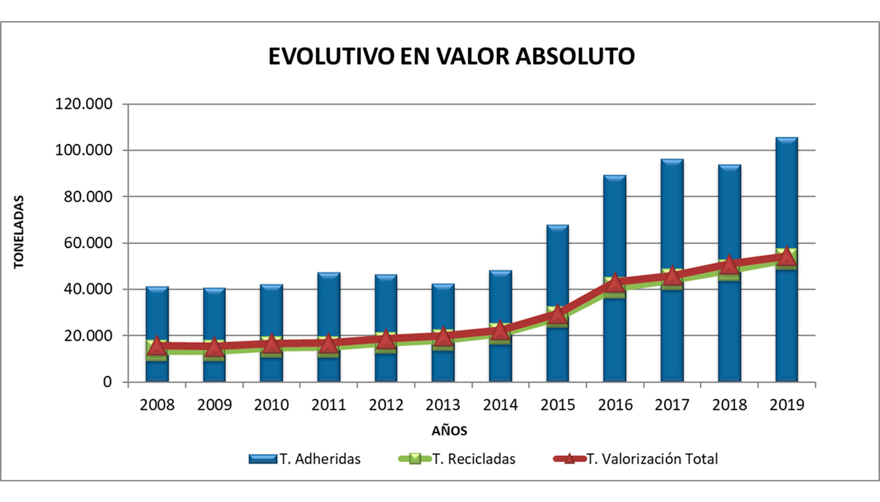
4.3 Aluminum:
Recycling aluminum in welding is crucial for both environmental sustainability and operational efficiency. Aluminum is known for its high recyclability because it can be recycled repeatedly without losing its physical properties. This expanded section focuses on specific practices, technologies, and strategies to enhance aluminum recycling management in welding processes.

Slide 7
Specific Practices for Aluminum Recycling in Welding:
1. Effective Waste Separation: As aluminum can easily be contaminated with other metals during welding, efficient waste separation systems are essential. This includes using dedicated containers to collect aluminum scraps only.
2. Collection of Scraps and Shavings: During welding and machining of aluminum, shavings and scraps are generated that can be collected for recycling. Implementing collection systems at the workplace facilitates this task.
3. Melting and Refining Aluminum Waste: Collected aluminum waste can be melted and refined to produce aluminum ingots. These ingots can be used to create new aluminum products, maintaining the material’s quality and properties.

Slide 8
Benefits of Aluminum Recycling in Welding:
Carbon Footprint Reduction: Recycling aluminum requires significantly less energy than producing primary aluminum, contributing to a notable reduction in CO2 emissions.
Conservation of Resources: Recycling aluminum conserves natural resources and reduces the need for mining and extraction.
Cost Reduction: Using recycled aluminum can lower material costs for manufacturers and welding workshops.
In summary, implementing sustainable practices in aluminum recycling in welding processes is essential for a more environmentally friendly, resource-efficient, and economically viable industry.

Slide 9
4.4 General Sustainability Practices in Welding:
Material Audits: Perform regular audits to identify opportunities to reduce, reuse, and recycle materials.
Continuous Training: Provide ongoing education to staff about sustainable practices and how to implement them efficiently.
Use of Advanced Technology: Adopt welding technologies that minimize waste generation and improve material efficiency.

Slide 10
5. Conclusions
1. Eco-Friendly Equipment and Materials: Adopting energy-efficient welding equipment and materials with low toxic content is crucial for environmental sustainability.
2. Emission Control and Adequate Ventilation: Implement smoke extraction and filtration systems to minimize exposure to harmful gases and fumes.
3. Recycling of Welding Materials: Essential for waste reduction, through the collection and recycling of metal scraps and consumables.
4. Safe and Responsible Work Practices: Include training and raising awareness among staff about environmentally friendly welding practices.
5. Energy Efficiency: Reduce energy consumption by turning off equipment when not in use and keeping it well-maintained.
6. Specific Metal Recycling: Carbon steel, stainless steel, and aluminum should be recycled properly, respecting their specific properties and compositions to maximize resource conservation and energy efficiency.

Slide 11
Any questions?
Thank you!

Slide 12
1. Introduction
Recycling in welding processes is a critical aspect for both environmental sustainability and operational efficiency. By recycling materials and minimizing waste, not only are valuable resources conserved, but the environmental footprint of welding is also significantly reduced. This responsible approach towards the environment helps to mitigate the release of pollutants, a matter of great importance in the welding industry.
In the welding process, the generation of contaminants is a constant concern. These pollutants, which include fumes, gases, harmful radiations, and particle projections, pose risks to both the health of workers and the environment. Identifying and understanding these contaminants is the first step towards implementing safer and more sustainable welding practices. In this context, we will explore the main pollutants generated during the welding process, highlighting the importance of efficient recycling strategies and waste management to minimize their impact.

