Slide 1
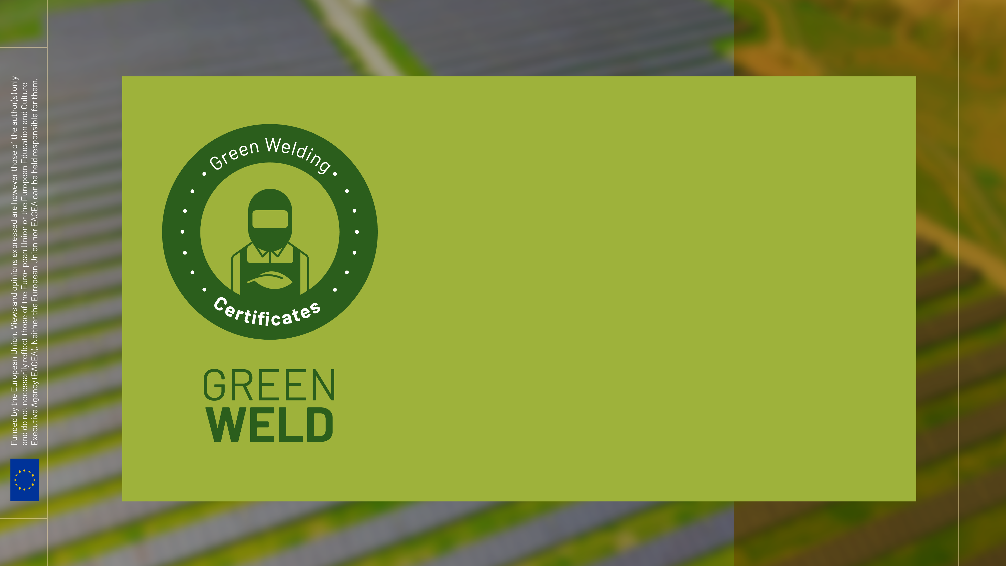
Awareness in Green Topis: Reduce, Recycle, Reuse - Part A2

Slide 2
Agenda
Procedures and activities to protect the environment
Usage and Handling of welding materials
Recycling carbon steel, stainless steel and aluminum

Slide 3
The main contaminating agents to take into account in welding processes are the following:
1.1 Fumes and Gases
1.2 Radiation
1.3 Noise and Particle Projection

Slide 4
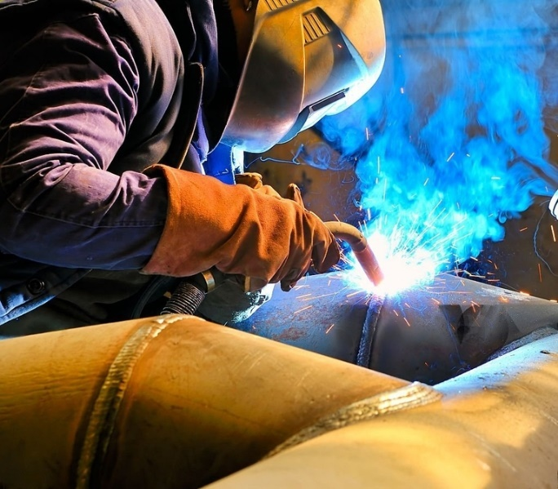
1.1 Fumes and Gases
During welding, fumes and gases are generated through chemical reactions of the involved components. These vary in characteristics depending on their source, notably:
Emitted by interaction with the surrounding air.
Originating from the base material.
Resulting from the coating or surface treatment of the base material.
Produced by the filler material, coatings, or fluxes used.
Emitted by liquids or gases present in the containers being welded.
Generated by degreasers or cleaning products used on the materials.

Slide 5
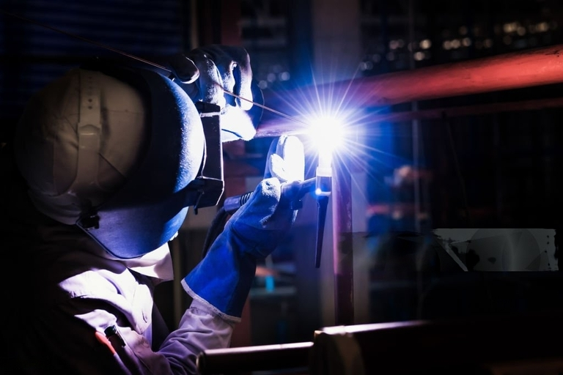
1.2 Radiation
Arc welding processes emit visible, ultraviolet, and infrared radiations, with ultraviolet being particularly harmful to the eyes and skin. On the other hand, flame welding produces similar radiations but at a lower intensity. As for resistance welding, it mainly emits infrared and visible radiations, which are less harmful.

Slide 6
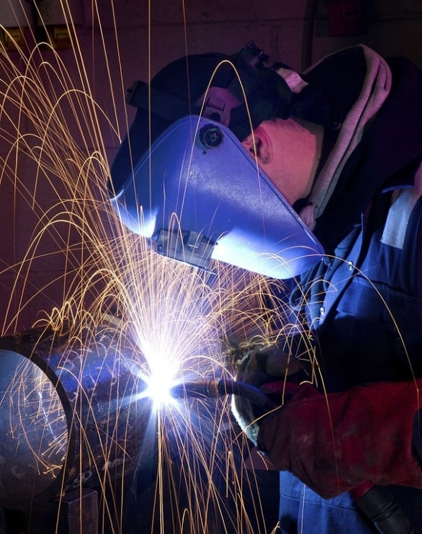
1.2 Noise and Particle Projection
The noise in welding comes from complementary tasks such as grinding, chipping, and hammering. Some methods, like plasma welding and certain types of resistance welding, can generate noises exceeding 90 dB.
Regarding particle projection, these can reach horizontal distances of up to 10 meters. The combination of these incandescent particles with gases and combustible materials, along with the generated heat, increases the risk of fires. Therefore, it is crucial to work in environments with fire-resistant floors, walls, and screens.

Slide 7
2. Procedures and activities to protect the environment:
To protect the environment in the context of welding, there are several procedures and activities that can be implemented. Welding, being a process that can involve the emission of fumes, gases, and other by-products, requires careful practices to minimize its environmental impact. Here are some recommendations:
1.Use of Eco-friendly Equipment and Materials
2. Emission Control and Ventilation
3. Waste Management
4. Responsible Energy Use
5. Training and Awareness of Personnel
6. Noise Minimization
7. Use of Alternative Welding Techniques
8. Regular Inspections and Maintenance

Slide 8
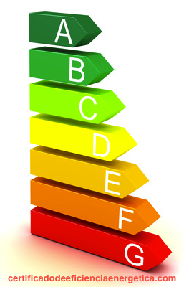
2.1 Use of Eco-friendly Equipment and Materials
- Prefer welding equipment that is energy efficient.
- Use welding materials with low content of heavy metals and other toxic elements.

Slide 9
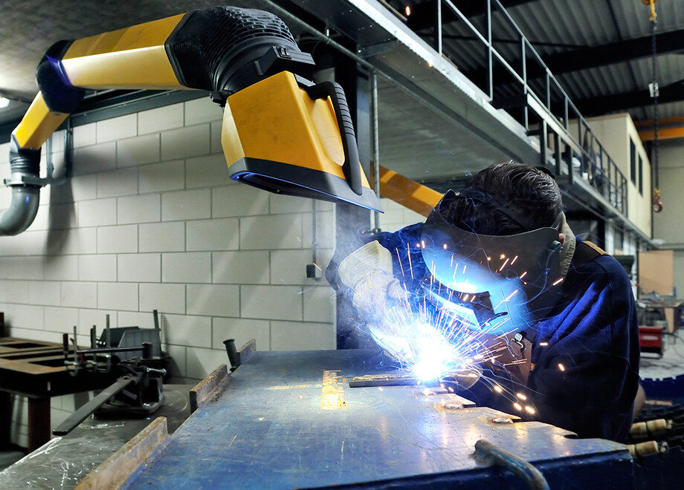
2.2 Emission Control and Ventilation
- Implement smoke extraction and filtration systems to capture harmful particles and gases.
- Ensure that the work area is well ventilated.

Slide 10
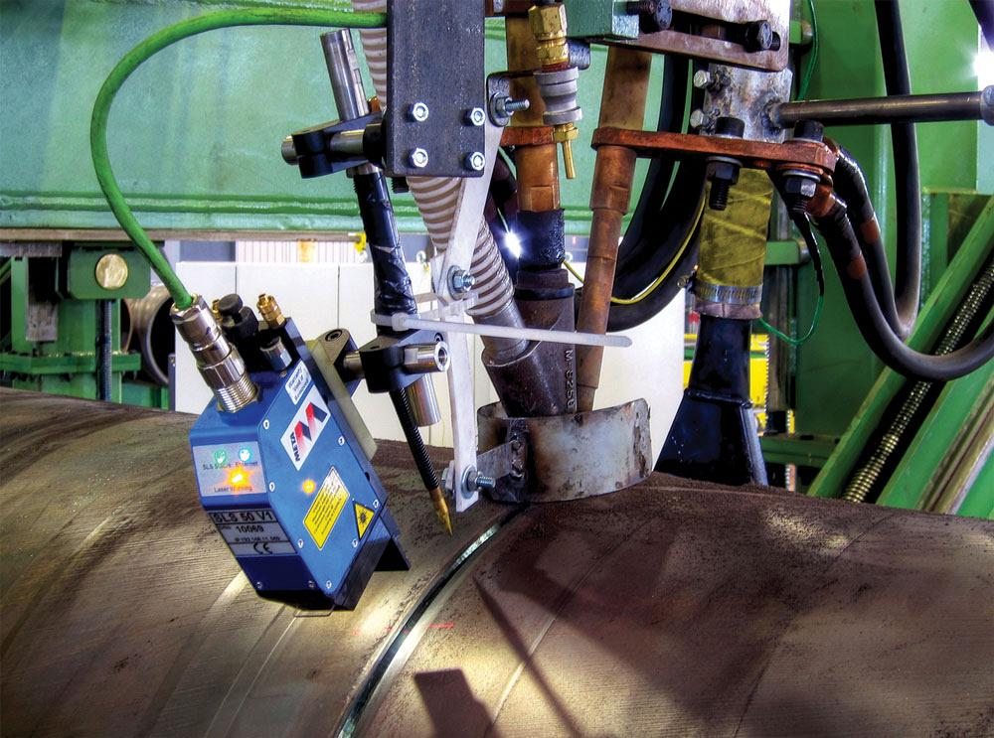
2.3 Waste Management
- Properly dispose of waste generated by welding, including used electrodes and metal scraps.
- Recycle materials whenever possible.

Slide 11
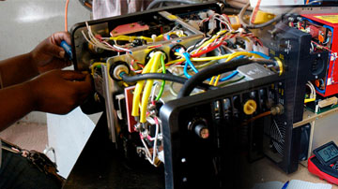
2.4 Responsible Energy Use
- Turn off welding equipment when not in use.
- Maintain welding equipment in good condition to ensure energy efficiency.

