Slide 1
GREENWELD Impact Measurement - Part B

Slide 2
Topics
Introduction
Overview of Welding Energy Consumption
Key performance indicators for Energy Efficiency
Balancing Energy Efficiency and Welding Quality
Energy-saving actions
Energy efficiency policies and industrial equipment

Slide 3
Introduction
Reuse, Reduce, and Recycle materials.
More eco-friendly welding process
Energy Performance

Slide 4
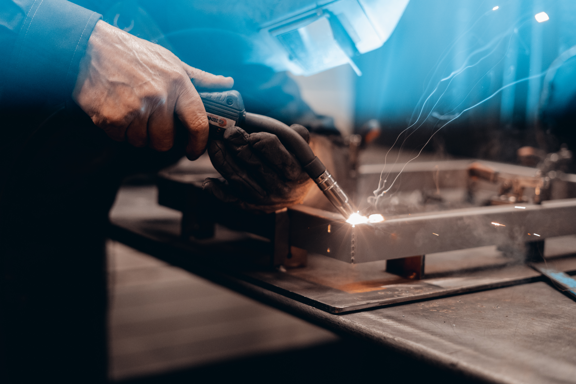
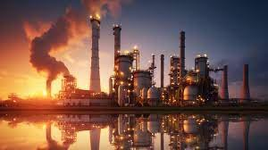
Overview of Welding Energy Consumption
The individuel welder
The welding facilities and companies

Slide 5
Overview of Welding Energy Consumption
The individual welders play a major role in influencing the energy efficiency of the welding process and reducing its emissions through several key parameters.
Utilization of welding wire
Techniques
2) Gas consumption
3) Electricity consumption
Machine settings

Slide 6
Overview of Welding Energy Consumption
Production companies or welding facilities also significantly influences energy performance.
Investing in the right equipment
2) Buying sustainable materials (gas, welding wire, Etc.)
3) Ensuring access to greener electricity

Slide 7
Key performance indicators for Energy Efficiency
Energy/gas consumed per unit of welding output
The amount of energy / gas consumed for each unit of welding output (could be related to length or time). This type of KPI works as a direct indicator of how efficiently energy is utilized in the welding process.
Improve the entire welding process time
Tracking the entire process time to complete the welding process, from setup to completion, can indicate process efficiency. As the machines are still consuming energy while on standby, preparing the welding stations in between tasks can reduce the overall process time.
Energy consumption during Standby time.
Standby time refers to the periods when the welding equipment is not actively welding. Reducing the standby time throughout an entire workday enhances operational efficiency and optimizes energy utilization.

Slide 8
Key performance indicators for Energy Efficiency
Utilizing welding materials
Evaluating the welding materials as a KPI assesses how efficiently materials are used in the welding process. This parameter is mainly related to the consumption of welding wire. As the welding wire has a significant impact on the total emissions of the welding process, using the right wire consump-tion makes a difference.
Machine settings and machine capabilities
On a company level, evaluating various machine settings and capabilities allows for comparisons and can serve as a foundation for potential investments to transition towards a greener and more energy-efficient machine setup.
Percentage of Energy from Renewable or Low-Carbon Sources
Another company, KPI, could assess the percentage of energy sourced from renewable or low-carbon alternatives within the total energy composition for welding. It indicates the environmental sustainability of the utilized energy sources.

Slide 9
Balancing Energy Efficiency and Welding Quality
Welding quality is closely intertwined with sustainability and environmentally friendly welding, and can't be comprimised when evaluating a green weld.
Below are three points on why quality is always the most sustainable;
Last for longer
2) No extra material is needed
3) No post-process

Slide 10
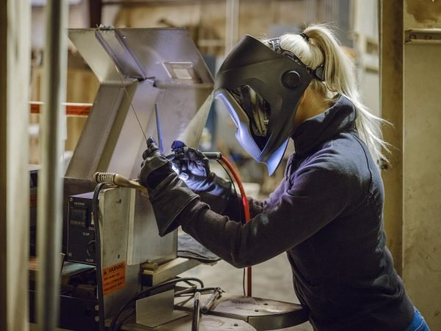
Energy-saving actions
Energy-saving actions include several different parameters for the individual welder to consider when combining quality with a sustainable approach, and it might differ from task to task.
Welding Methods
Welding techniques
Machine settings

Slide 11
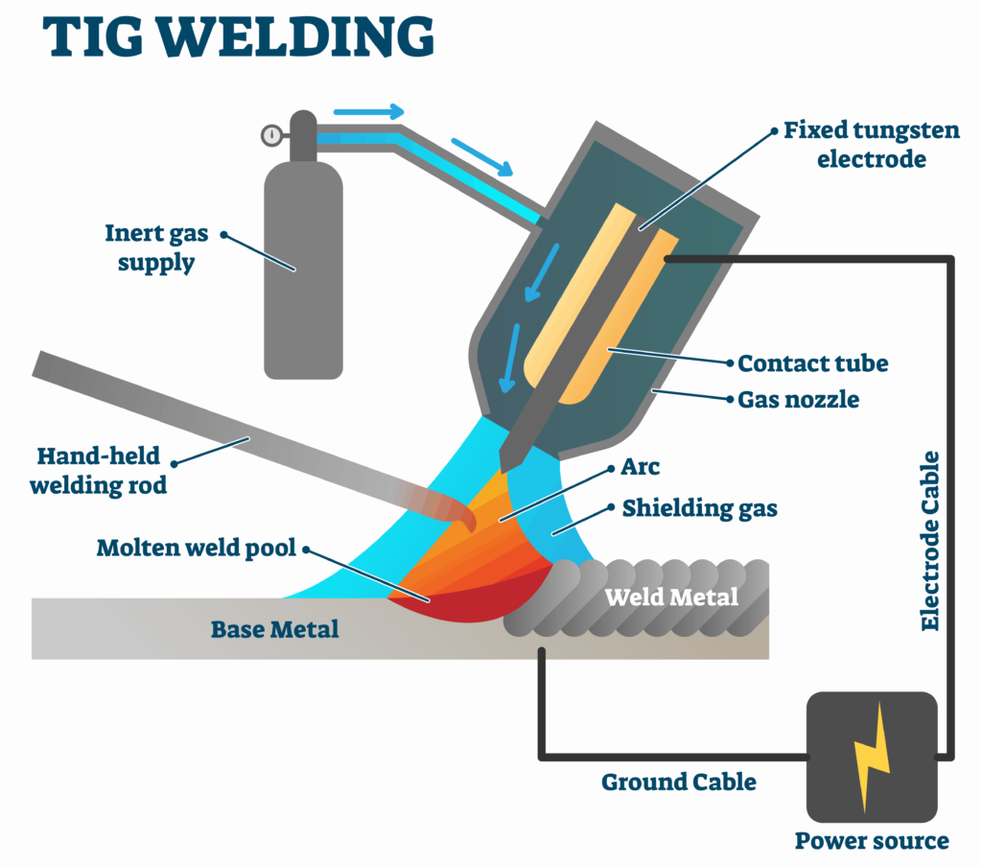
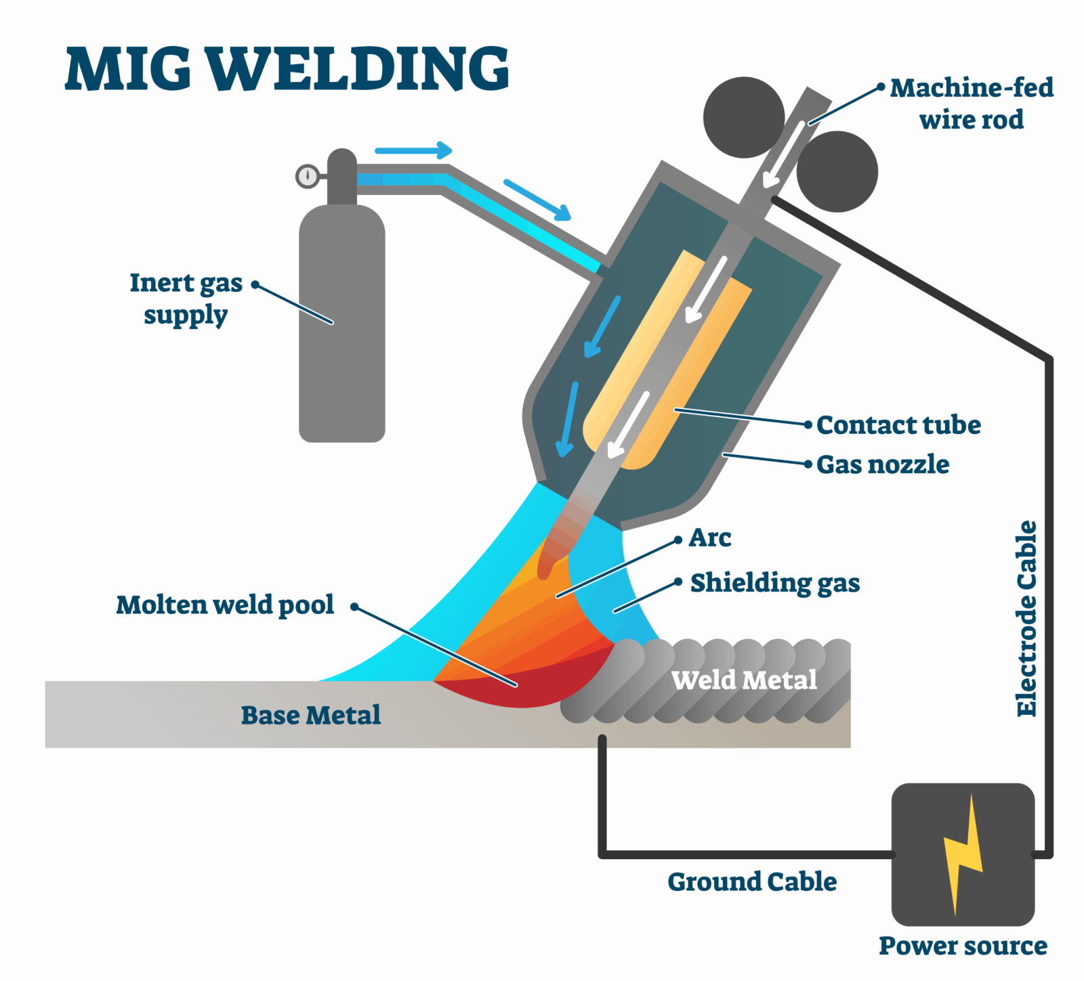
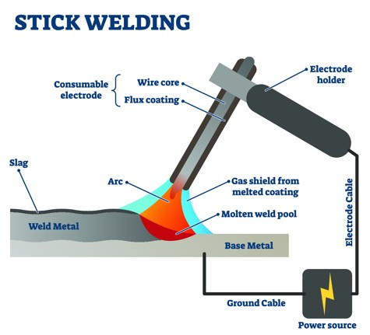
Energy-saving actions
Welding Methods
Some welding methods are more efficient than others, and it is important for the welder to be able to know the difference in order to make a better choice. However, the choice should first and foremost be based on the quality level for the given task.

Slide 12
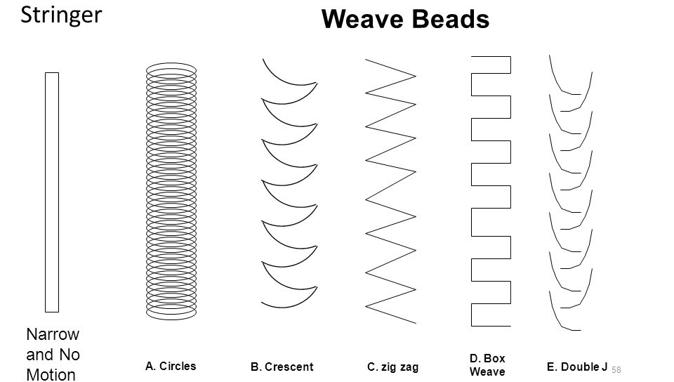
Energy-saving actions
Welding techniques
Furthermore, specific techniques, like stringing and weaving welding techniques will have an impcts on the energy consumption. The average power consump-tion is reduced, and thus energy loss is minimized when stringing a weld instead of weaving, as a lot of heat is generated in the material during weaving.
However, weaving might be the correct welding in some cases. So, it is important to know how different techniques perform to make the right choise.

Slide 13
Energy-saving actions
Machine settings
Ensuring that the settings on the welding machines align with the specific task, including the materials used, task requirements, and welding technique, is critical for improving energy efficiency.
Regarding welding techniques, these parameters vary based on different factors that welders must consider, depending on the specific task and machine type. Below are some machine settings that could be taken into consideration.
Voltage (V):
Voltage impacts the energy input and heat generated during the welding process.
Amperage (A):
Amperage regulates the welding current, affecting the heat produced.
Wire Feed Speed (WFS):
Managing the wire feed speed influences the overall energy consumption, and efficiency of the process, as well as the material usages.
Gas Flow Rate:
Adjusting the flow rate can impact the efficiency of gas usage, contributing to energy savings.
Pulse Settings:
Utilizing pulse settings can enhance control and reduce overall energy consumption. (not all machines allow adjust-ment of the pulse.)
Arc Length:
The optimal arc length is essential for efficient welding. Adjusting this parameter can impact energy efficiency and the quality of the weld.

Slide 14
Energy efficiency policies and industrial equipment
Investing in efficeint equipment
When evaluating welding equipment from a sustainability standpoint, the key is to find a machine with optimal performance based on energy consumption.
One parameter to assess is the efficiency of electricity usage and how flexibly and effectively the welding machine controls the transition from the welding process.
More sustainable materials
Sustainable resources, whether it is an energy supply from renewable sources, more sustainable gas compositions, or eco-friendly welding materials, are all parameters that production companies or welding institutes can improve to support their welders and move towards a greener future.
Renewable energy source
Adopting renewable energy in welding facilities reduces carbon emissions and ensures a reliable energy supply.
Beyond environmental benefits, it enhances cost-efficiency, contributing to greener practices and meeting the demand for sustainable solutions in the welding industry.

Slide 15
Any questions?
Thank you!

