Slide 1
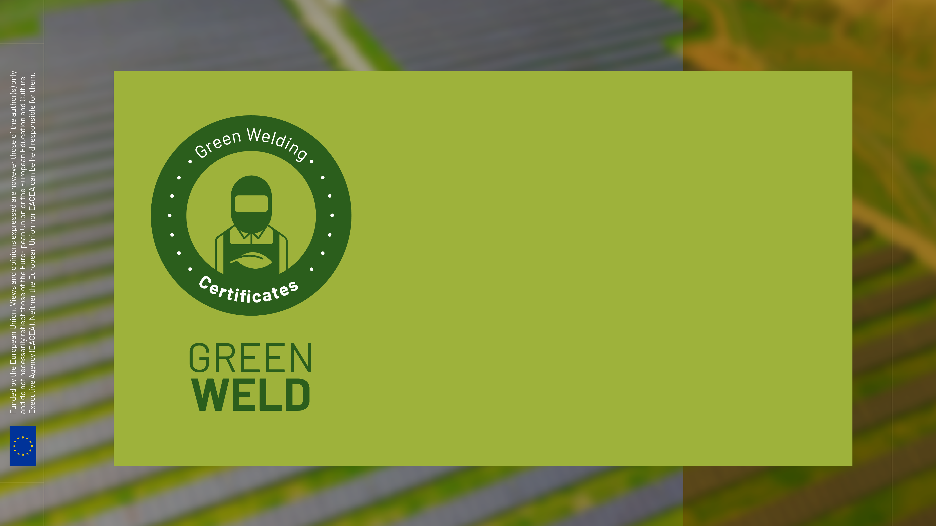
GREENWELD Impact Measurement - Part C

Slide 2
Agenda
Training Digital Tools and Methodology
Learning Management System (LMS)
Welding Simulators

Slide 3
1. Introduction
The present document ensures the accumulation of digital skills necessary for the use of digital devices that create virtual and augmented reality. The implementation of the virtual environment and augmented reality in the practical training of future welders ensures the access of the new generation to a training mode close to the reality in which they live and carry out their daily activities.
The module deals with aspects regarding the methodology and tools used in digital training, learning management systems and a brief presentation of welding simulators.

Slide 4
The first topic covers subjects related to digital tools used in welding training and which are the advantages and disadvantages of using digital tools in welding.
The second topic introduces the trainees in the virtual learning environments where they can learn and interact with digital tools or with other trainees. The learning management systems (LMS) are the best digital tools to register users, to provide content and to assess the performance of the trainees. How an LMS can be defined, set up and which are the functionalities of a LMS as well as the advantages and disadvantages of a LMS are presented in this module. The trainees will also learn about available solutions for developing their own LMS.
The third topic deals with welding simulators. Typical welding simulator system are presented in the introduction of the document. The virtual reality (VR) and augmented reality (AR) are explained in order to provide to the trainees the necessary knowledge in order to be able to understand and to use how these technologies work. At the end of the document a brief presentation of the difference between welding simulator and real welding system as well as a short example regarding the setting of a welding simulator.

Slide 5
2. Training Digital Tools and Methodology
This topic covers subjects related to digital tools used in welding training and which are the advantages and disadvantages of using digital tools in welding. Several software applications used in welders training are presented in order to show the importance and the relevance of digital tools in learning process.
There are two ways in which information is transmitted to students: the first refers to the teacher being at the center of the learning activity, and the second one puts the student in the middle of all activities. The use of digital tools in the learning activity can be successfully applied to the second option, considering the affinity of young people for everything that means connectivity and making information available in any place, time and way.

Slide 6
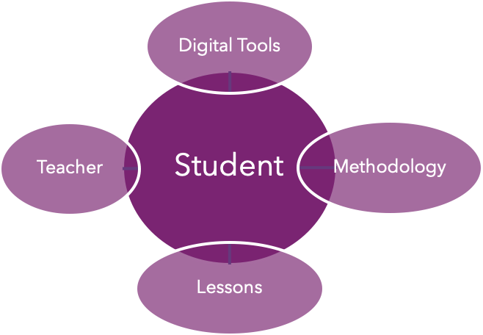
Student-centered learning can be achieved if a few rules are followed:
Being clear about how you will promote, measure, and celebrate understanding.
Modeling how to think for students.
Helping students understand what’s worth understanding.
Diversifying what you accept as evidence of understanding.
Creating curriculum and instruction around a need to know.
Collaborating with students to create the rubric or scoring guide.
Letting students choose the project’s purpose.
Letting students choose their own media form that reflects the purpose of
the reading.
Using the on-demand writing prompt as the summative assessment.
Framing learning in terms of process and growth and purpose.

Slide 7
Digital tools used in welding training
The digital tools used mainly in the training of people in the welding profession are largely dedicated to the theoretical aspects presented in digital format (doc., pdf., ppt., Images and videos) as well as the evaluation process related to the subjects taught. Newly, the information is incorporated into applications dedicated to learning that include both electronic documents and video images and animations all being compiled in an interactive way.
FutureWeld learning app
b. FutureWeld assessment app
c. Microbond learning app
d. Microbond assessment app

Slide 8
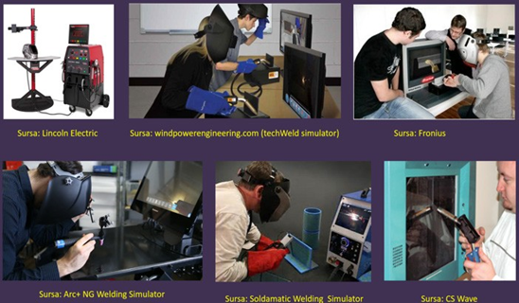
The next step is to combine theoretical and practical training, and this can be achieved through welding simulators. Welding simulators can support both theoretical, practical and online or offline assessment of the student.

Slide 9
TIPS:
Digital tools mean any software application or electronic device which is used in training.
Software applications are mostly used for theoretical training and examination of the trainees knowledge.
Welding simulators can be used both for theoretical and practical training in welding, as well as in examination process.

Slide 10
Advantages and disadvantages of digital tools in welding:
The use of welding digital tools presents both advantages and disadvantages for the process of learning and training future welders. The main advantages of simulated welding are:

Slide 11
In terms of disadvantages, the simulation of welding processes cannot substitute the real welding. There two categories of disadvantages identified:
HUMAN RESOURCE | LIMITED TECHNOLOGY
-Lack of digital skills of the teachers/trainers regarding the integration of welding simulators into the learning process. -Lack of digital skills of the teachers/trainers regarding the integration of welding software applications into the learning process. | -The welding simulators allow the practical training in order to improve the skills of the trainees, but it doesn’t cover the other aspects related for instance to base material preparation. -There are some technological limitations regarding the arc ignition which are different by the real welding. -Not all welding processes can be digitalized in welding simulator.

Slide 12
3. Learning Management System (LMS)
Digital tools can be defined as any devices and technologies of transmitting knowledge from teacher to student with computer applications, online course media or practical training through devices that use augmented reality, virtual reality, etc.
Digital tools are designed to help the students and teacher in the learning process. This sub-chapter contains basic information regarding digital tools and specific methodologies for learning process in a digital environment.

Slide 13
3.1 Virtual Learning Environments
Virtual Learning Environment (VLE) consists of a digital system that provides educational materials (courses, presentations, videos, animations and software applications) to the students using online webpages. Using an Internet connection on their own digital tools (computers, tablets, smartphones, etc.) the users can access the information 24 hours a day and 7 days a week. A VLE supports student’s registration, tracking of their activities, collaboration and communication between students, teachers, and assessment. There are three different types of VLEs.
-Open source
-Bespoke
-Of-the-self

Slide 14
3.2 Definition and characteristics of LMS:
A Learning Management System (LMS) is the same thing as Virtual Learning Environment (VLE). Another name for LMS is Course Management System (CMS). As a general definition, the Learning Management System is a software application or web-based technology for planning, implementing and assessing a specific learning process. The main characteristics of LMS are:
Possibility to upload or create and deliver content related to educational materials.
Monitor the student participation and continuous assessment for improvement the learning process and student performance.
Tool for interactive features such threaded discussions, video conferencing, forums, etc.

Slide 15
3.3 Setting and functionalities of LMS:
The functionalities of a LMS are defined in most cases by the developer. However, minimal functionalities should be provided by any LMS.
Reports
Analysis
Customization
Assessment
Communication

Slide 16
3.4 LMS – challenges and advantages:
The advantages of LMS in learning process are well known by the institutions, which are using the system. At least three major benefits can be identified when a LMS is implemented and use in learning process.
The challenges are also high when a LMS is implemented for more than one programme study. The digital templates for courses, presentations, videos and software applications must cover all aspects related to the development of educational materials. One major challenge is related to harmonization and exchange of information between two learning management systems. Trainees from different companies, centers, etc., should be able to exchange information with other colleagues using the features of the LMS.

Slide 17
4. Welding Simulators
The technological evolution has allowed the use of simulators for the training of welding trainees in order to obtain the necessary skills for insertion in the labour market or improve their skills. Most modern simulators are run by a personal computer and employ software, which enables a variety of processes. These include setting up (i.e. selection of base materials, weld type, weld settings, etc.), performance assessment, and provision of feedback, in line with the second and third training principles.

Slide 18
4.1 Welding simulators systems:
Welding simulators are built using modern technologies like Virtual Reality (VR) or Augmented Reality (AR). These technologies provide the simulator display and visual feedback. In VR systems, a Head Mounted Display (HMD) creates the LVE. The welder cannot see the actual gun and welding surfaces; instead, they see a virtual representation of these projected onto the HMD. In AR systems, a digital image or animation is superimposed on the real image that can be viewed through monitors. Unlike the VR systems, in the AR systems, the welder can see the gun and welding surfaces they are interacting with. In both VR and AR systems, virtual imagery is used to provide visual feedback. A separate monitor is also generally included to allow instructors to view student performance and review feedback after welding completion.

Slide 19
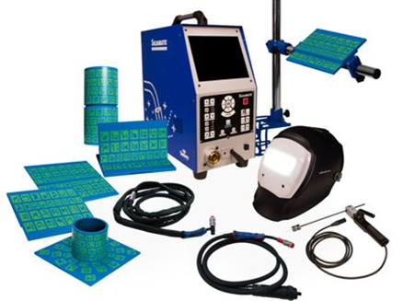
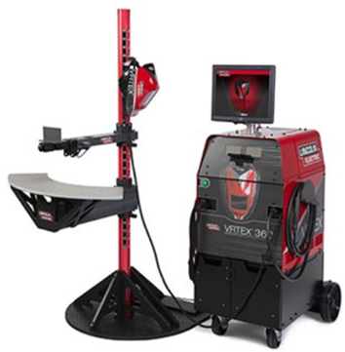
Augmented Reality (AR)
Virtual Reality (VR)

Slide 20
4.2 Augmented Reality:
Augmented Reality (AR) technology allows the blending the real and virtual worlds. AR applications can translate that particular coded image into a virtual item on the screen. Some camera apps even include the option to add virtual elements to a photo, along with some measure of 3D sensing that allows them to move around the picture as if they were part of the scene. AR is a live direct or composite view of a physical, real-world environment superimposed with virtual elements, which have augmented (enhanced) by computer-generated sensory input such as sound, video, graphics or GPS data. The most common applications known by users are related to QR scanning codes and games such Pokemon Go.

Slide 21
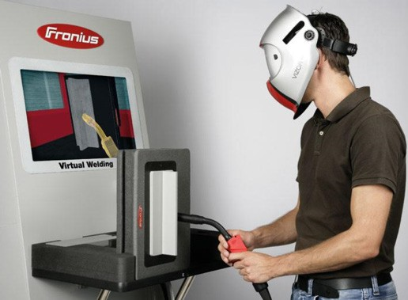
4.3 Virtual Reality:
Virtual Reality (VR) technology aims to create realistic 3D environment that user can perceive as real. The user can even interact with in realistic way. The LVE can be created on a display computer or on VR headset (HMD).
A VR headset can integrate both hardware and software components and can include only software components but, in this case, a computer is required. A complete VR device should contain the necessary components in order to provide best experience

Slide 22
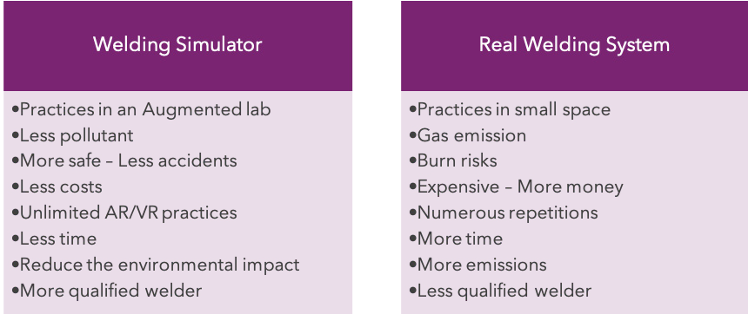
4.4 Difference between welding simulator and real welding system:

Slide 23
4.4 Set-up of welding simulators:
We can find different configurations depends on the manufacturer that we choose. In all cases, the welding simulator includes a complete user manual (pdf-doc, online or both). These tend to be more or less extensive depending on the benefits they offer. For example, the first and one of the most completed welding simulation solutions called “SOLDAMATIC” includes an owner´s manual with a dedicated section about set-up tasks. Normally these tasks are grouped in:

Slide 26
to control energy consumption during welding
Green Actions and Strategies
5. Green Weld Good Practices:
Pulse Welding
Process Selection
Choose welding processes that are inherently more environmentally friendly.
Pulse welding can reduce heat input, minimize distortion, and can reduce overall energy consumption.
Optimized Welding Parameters
Welding Procedures
Make use of standardized procedures that focus on achieving the desired weld quality with the least energy consumption.
Adjust welding parameters such as voltage, current, and travel speed to optimize energy consumption while maintaining weld quality

Slide 27
to control energy consumption during welding
Green Actions and Strategies
5. Green Weld Good Practices:
Advanced Power Sources
Scheduled Maintenance
Invest in advanced welding machines with inverter technology and high energy efficiency.
Maintain welding equipment regularly to ensure optimal performance.
Use Power Factor Correction
Idle-Time Reduction
Power factor correction devices can be used to improve the efficiency of electrical systems.
Turn off welding machines and related equipment when are not in use

Slide 28
to control energy consumption during welding
Green Actions and Strategies
5. Green Weld Good Practices:
Energy Recovery Systems
micro-welding for precision of small components, which reduces the total amount of material and energy required
Cold and Micro
Install energy recovery systems that save and reuse energy generated during the welding process.
Choose cold welding methods that require less heat input, reducing energy consumption and minimizing thermal impact.
Lightweight Materials
Material Efficiency
lightweight materials and advanced alloys, which may require less energy to weld.
precise cutting and fitting contributes to energy efficiency.

Slide 29
to control energy consumption during welding
Green Actions and Strategies
5. Green Weld Good Practices:
Energy-Efficient Consumables
Water-Based Fluxes
welding consumables with high deposition rates and low environmental impact,e.g. lower resistance and improved conductivity
more environmentally friendly and produce fewer emissions
Green Filler Materials
Reduced Gas Emissions
made from recycled or sustainable materials with high deposition rate .
shielding and protective gases with lower global warming potentials (GWPs) to reduce greenhouse gas emissions.

Slide 30
to control energy consumption during welding
Green Actions and Strategies
5. Green Weld Good Practices:
Energy-Efficient Facility Designation
Recycling and Reusing
Proper insulation, natural lighting, and ventilation can contribute to the total energy savings.
reduces the need for new production and minimizes the environmental impact
Energy Management Systems
Energy-Efficient Lighting
LED lighting may provide adequate illumination with lower energy consumption
to monitor and control energy usage during welding operations

Slide 31
to control energy consumption during welding
Green Actions and Strategies
5. Green Weld Good Practices:
Continuous Improvement
Regulatory Compliance
regularly assessments and implementation of new technologies and practices
comply with energy efficiency regulations and standards applicable to welding operations
Monitor and Rate Energy Usage
Life Cycle Assessment
track energy usage during welding processes. Performance rating helps identify areas for improvement and sets targets for energy reduction
evaluate the environmental impact of welding processes

Slide 32
to control energy consumption during welding
Green Actions and Strategies
5. Green Weld Good Practices:
Automation and Robotics
Renewable Energy Sources
Automated systems can optimize welding parameters, reduce errors, and improve the total efficiency
powering welding operations by using renewable energy sources such as solar or wind power

Slide 33
5. Green Weld Good Practices:
Choosing Gases for Environmentally Friendly Welding
Efficiency and Cost: Consider the overall efficiency and cost-effectiveness of the chosen shielding gas
Process Optimization: Optimize welding parameters and processes to minimize the environmental impact while maintaining welding quality
Gas Mixtures: Use gas mixtures that balance the need for good welding quality with environmental considerations
Extra Tip!
Low-Emission Gases: Choose shielding gases that contribute to lower emissions, such as inert gases like argon
Advanced Gas Mixtures: Explore advanced gas mixtures designed for specific applications, which may offer improved performance and reduced environmental impact
Emission Monitoring: Regularly monitor emissions and assess the environmental impact of the chosen shielding gases
Gas Recycling: Implement gas recycling systems to reduce overall consumption and waste.

Slide 34
Green Actions and Strategies
5. Green Weld Good Practices:
Joint Preparation and Fit-Up
Let’s go Technical!
Travel Speed
Adjust the welding travel speed to achieve optimal deposition rates while maintaining quality. A consistent travel speed helps control the heat input and energy consumption.
Ensure proper joint preparation and fit-up to reduce the amount of filler material
Preheating and Interpass Temperature Control
Gas Efficiency
Optimize shielding gas selection and flow rates. As they can contribute to energy savings and improved welding performance
Ensure that water-cooled systems are efficient and that the cooling requirements match the application
Cooling Systems
preheating and control interpass temperatures appropriately to reduce the energy needed for welding thicker materials

Slide 35
5. Green Weld Good Practices:
Green Welding and productivity
Technology Adoption: Embrace advanced technologies and automation to streamline welding processes. While initial implementation may require time and investment, the long-term benefits can include increased production efficiency.
Training and Skill Development: Proper training and skill development for welders are essential when introducing new gases or optimizing processes. This may have an initial impact on production time but can lead to long-term efficiency gains.
Balancing Efficiency and Environmental Impact: Striking a balance between environmentally friendly practices and production efficiency is crucial. Evaluate the overall impact on both aspects when choosing gases and implementing emission reduction measures.
Extra Tip!
Continuous Improvement: Regularly assess and improve welding processes to enhance efficiency and reduce environmental impact. This may involve adopting new technologies or fine-tuning existing practices.
Emission Monitoring and Compliance: Allocate time for periodic emission monitoring and compliance checks to ensure adherence to environmental standards. This is essential for maintaining an environmentally friendly operation.
Collaboration and Expert Consultation: Work with experts in environmental and welding technologies to identify the most suitable gases and practices for your specific application. Collaboration can lead to informed decisions that balance environmental considerations and production efficiency

Slide 36
Things to Think!!
5. Green Weld Good Practices:
in respect to emissions
Automation
Consumable Selection
Consider automation to improve efficiency and reduce emissions
Choose low-emission consumables and filler materials
Implement strategies to reduce waste generation and promote recycling.
Waste Reduction
Material Efficiency
Choose processes that maximize material efficiency and minimize distortion.
Energy Efficiency
Optimize welding parameters for energy efficiency
Advanced Processes
Emission Monitoring
Explore advanced processes like friction stir welding for specific applications
Regularly monitor and assess emissions to identify improvement opportunities

Slide 37
Any questions?
Thank you!

